Slide 1
Finite Automata
Aman Shakya

Slide 2
Introduction
Mathematical models of computers and algorithms
Finite Automaton or Finite State Machine
A severely restricted model of an actual computer
Has a "central processing unit" of fixed, finite capacity
Input - a string of symbols delivered on an input tape
Output - indication of whether or not the input is considered acceptable
Fixed memory built “at the factory” - absence of memory outside its fixed central processor
A Language Recognition device

Slide 3
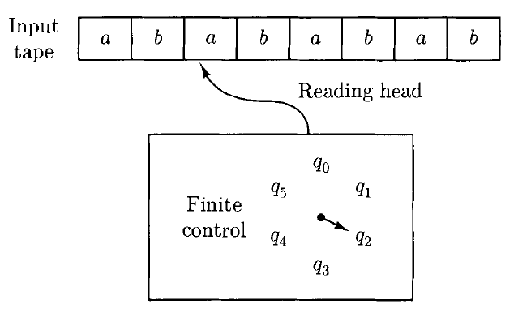
Finite Automaton

Slide 4
Components of Finite Automata
Input tape
Finite control
Black box with finite distinct internal states
Reading head
Initially, placed at the leftmost square of the tape and the finite control in an initial state.
A Deterministic Finite Automaton (DFA) reads one symbol from the input tape and then enters a new state that depends only on the current state and the symbol just read

Slide 5
Finite Automaton
Eventually the reading head reaches the end of the input string
The automaton then indicates its approval or disapproval of what it has read by the state it is in at the end
If it winds up in one of a set of final states the input string is considered to be accepted.
The language accepted by the machine is the set of strings it accepts.

Slide 6
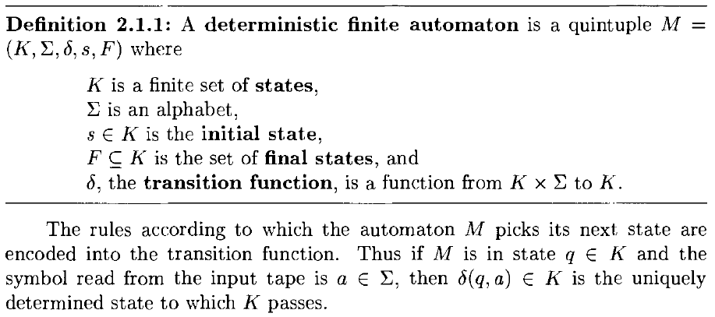
Deterministic Finite Automaton

Slide 7
Deterministic Finite Automata
Configuration
determined by the current state and the unread part of the string being processed
Configuration of a deterministic finite automaton

Slide 8

Configuration of Finite Automaton
Configuration =

Slide 9
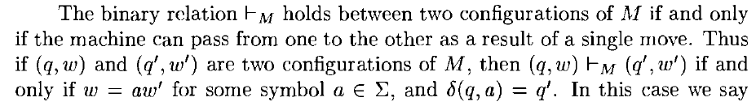
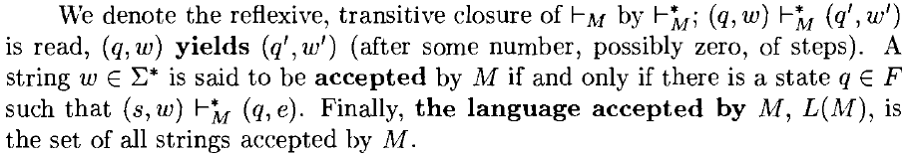
Configurations

Slide 10
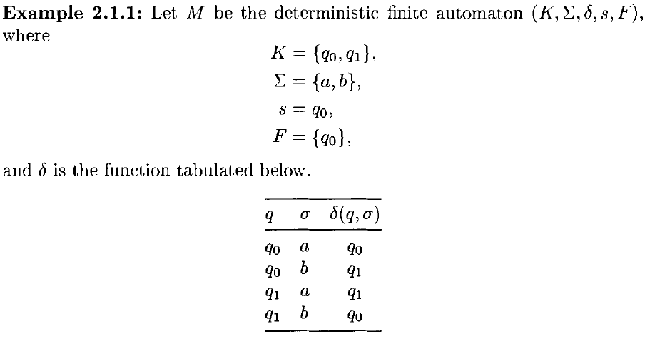
Example

Slide 11
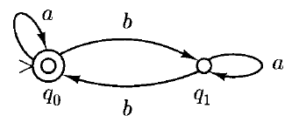
State Diagram

Slide 12
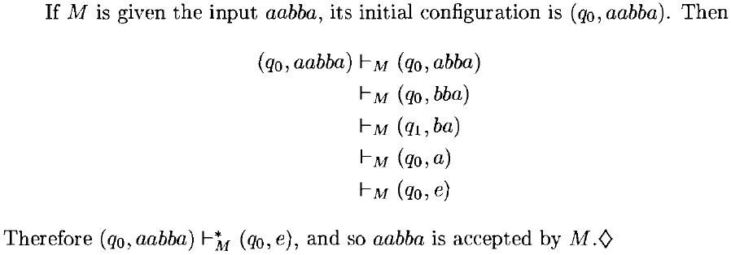
Example

Slide 13
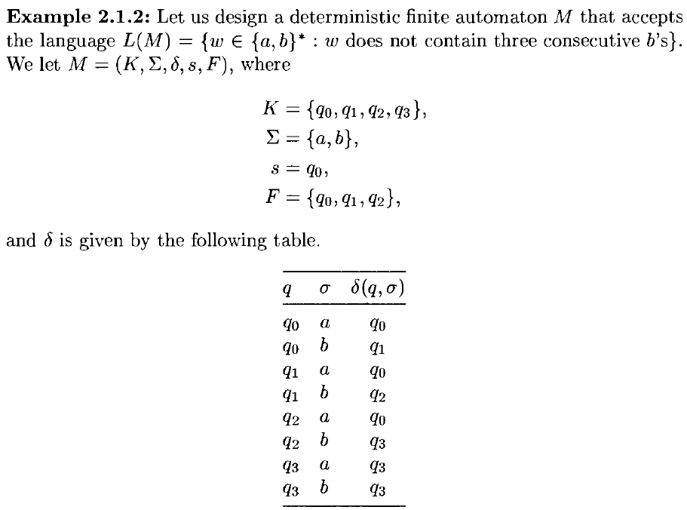

Slide 14
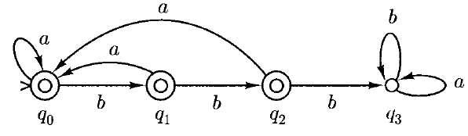
State Diagram
Dead State

Slide 15
Nondeterministic Finite Automata (NDFA)
Permit several possible "next states" for a given combination of current state and input symbol
Nondeterminism can greatly simplify the description of automata
we will see that every nondeterministic finite automaton is equivalent to a deterministic finite automaton

Slide 16

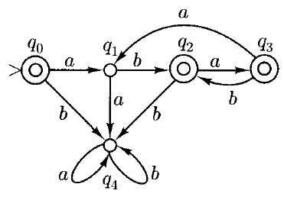
Example
DFA

Slide 17
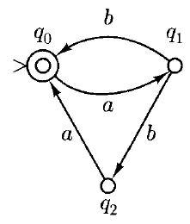
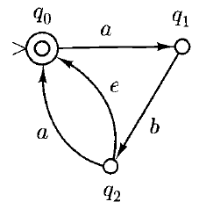
NDFA

Slide 18
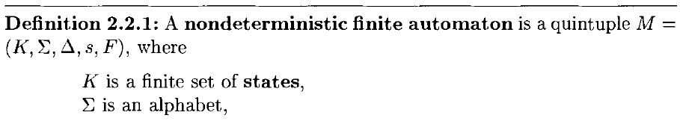
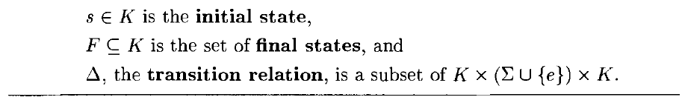
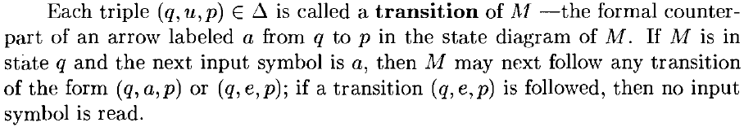
Nondeterministic Finite Automata

Slide 19

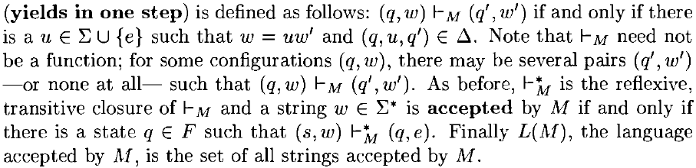
Configuration
Configuration of M is

Slide 20
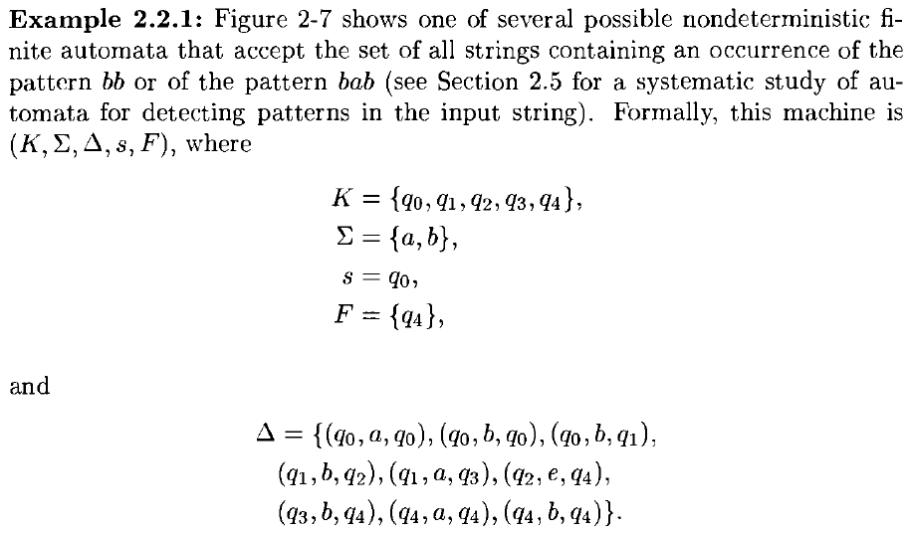

Slide 21
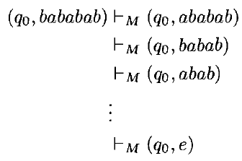
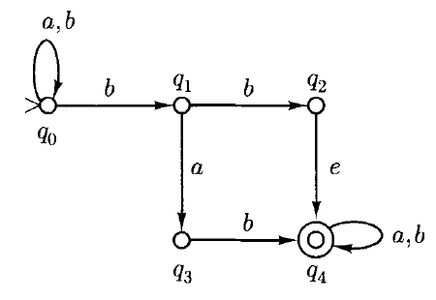
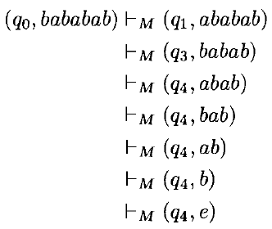
Example

Slide 22
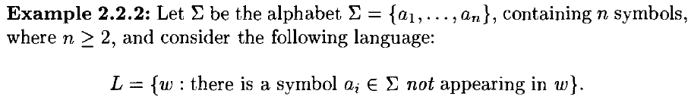
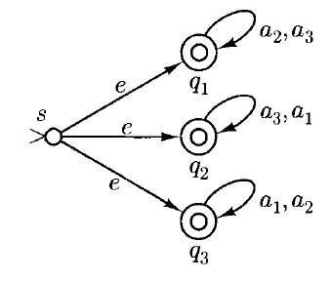
Example

Slide 23
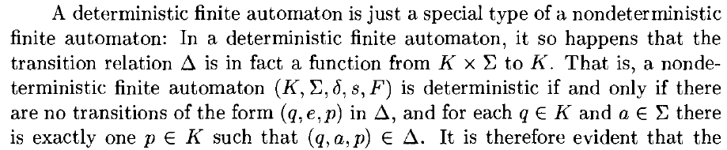
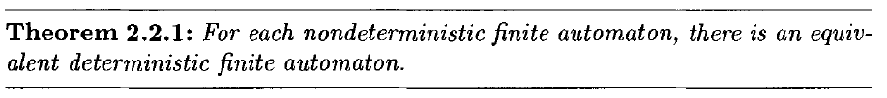
DFA and NDFA

Slide 24
Constructing DFA equivalent to NDFA
The key idea is to view a nondeterministic finite automaton as occupying, at any moment, a set of states that can be reached from the initial state by means of the input consumed thus far.
Thus if M had five states {q0, ... , q4} and, after reading a certain input string, it could be in state q0, q2, or q3, its state could be considered to be the set { q0, q2, q3}.
And if the next input symbol could drive M from go to either q1 or q2, from q2 to q0, and from q3 to q2, then the next state of M could be considered to be the set { q0, q1 , q2}

Slide 25
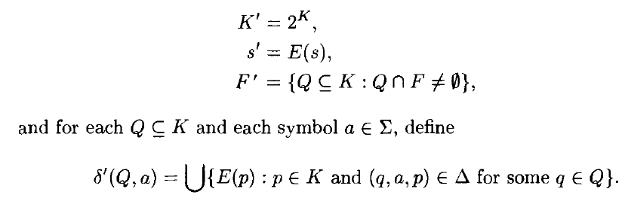

Constructing DFA equivalent to NDFA

Slide 26
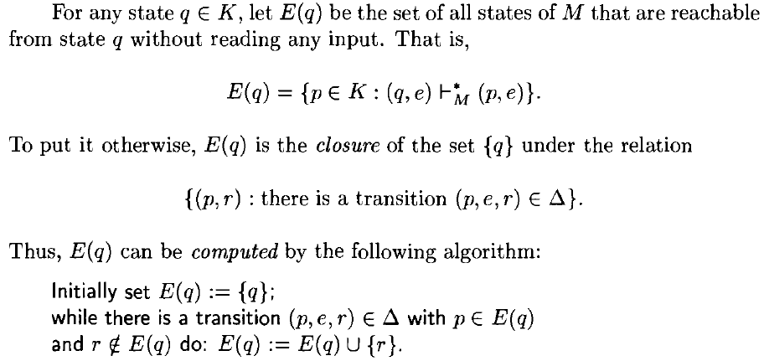
Constructing DFA equivalent to NDFA

Slide 27
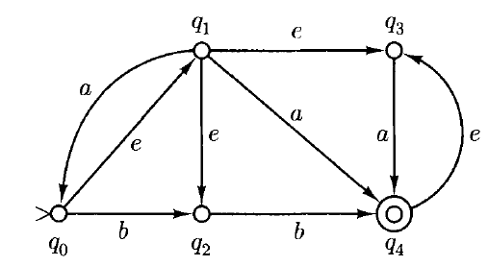



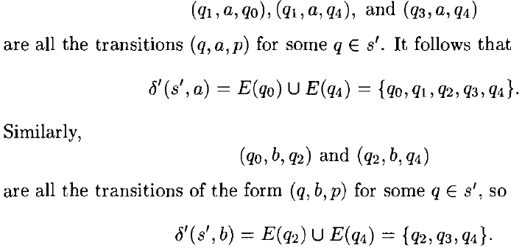
Example

Slide 28
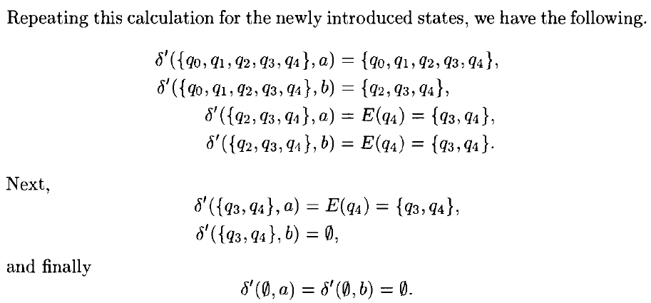
Example (contd.)

Slide 29
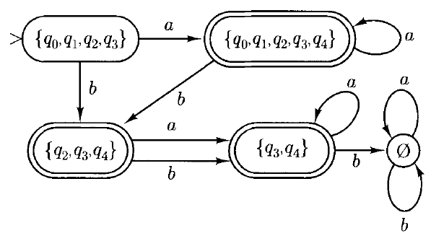
Example (contd.)

Slide 30
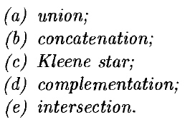

Finite Automata and Regular Expressions

Slide 31
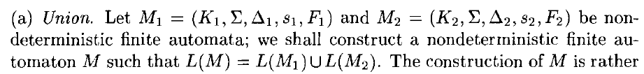
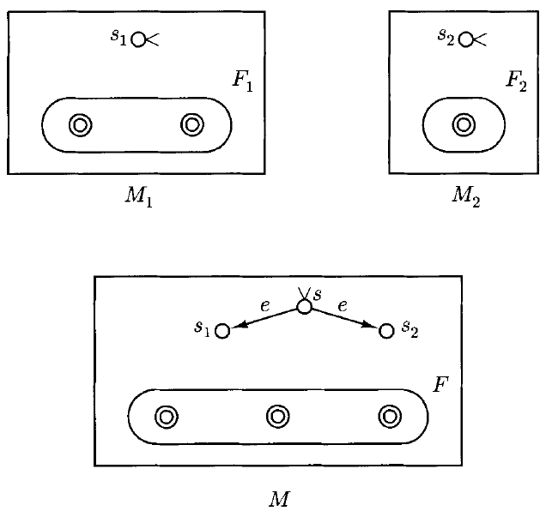
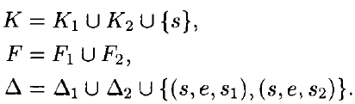

Slide 32

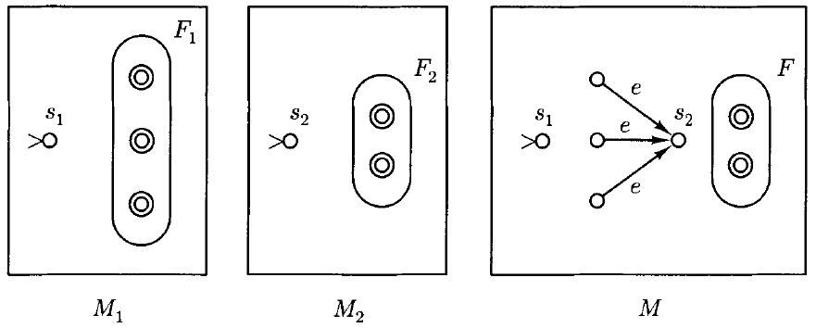

Slide 33
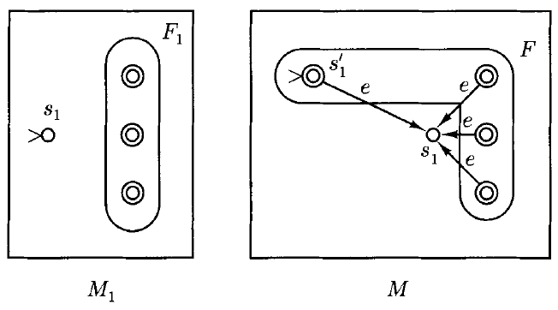

Slide 34
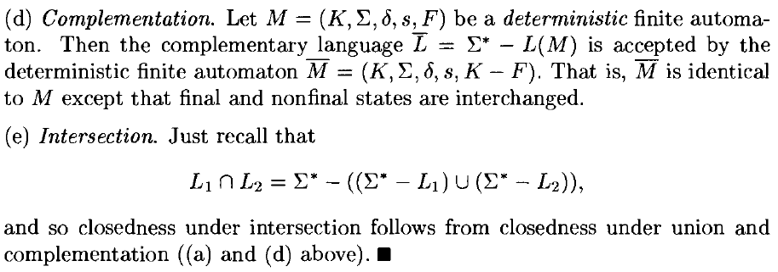

Slide 35

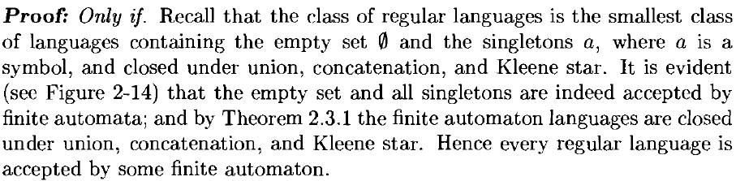
Finite Automata and Regular Expressions

Slide 36
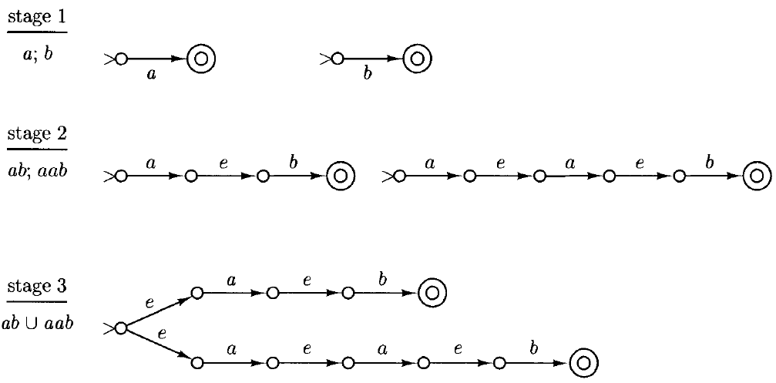

Slide 37
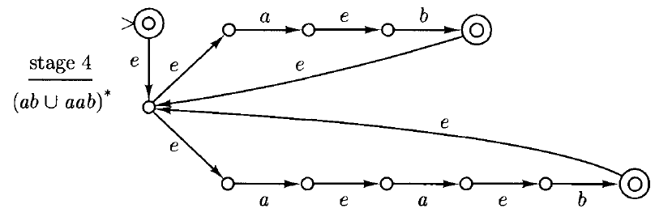

Slide 38
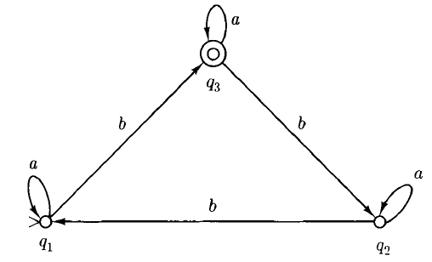
Example
If part: A language is regular it is accepted by a finite automaton

Slide 39
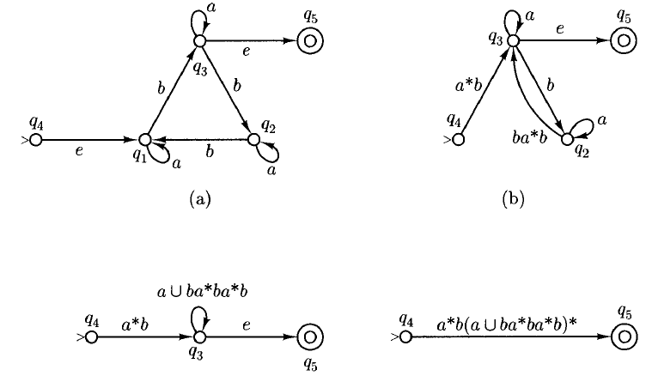
Example (contd.)

Slide 40
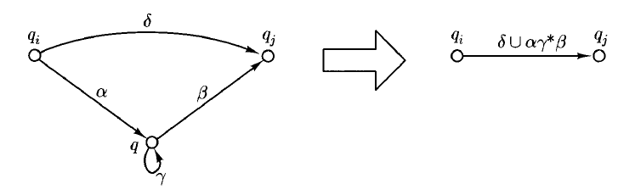

Slide 41
Languages that are and are not Regular
Two properties shared by all regular languages, but not by certain nonregular languages
As a string is scanned left to right, the amount of memory that is required in order to determine at the end whether or not the string is in the language must be bounded, fixed in advance and dependent on the language, not the particular input string. Eg, is not regular
Regular languages with an infinite number of strings are represented by automata with cycles and regular expressions involving the Kleene star. Such languages must have infinite subsets with a certain simple repetitive structure. Eg

Slide 42
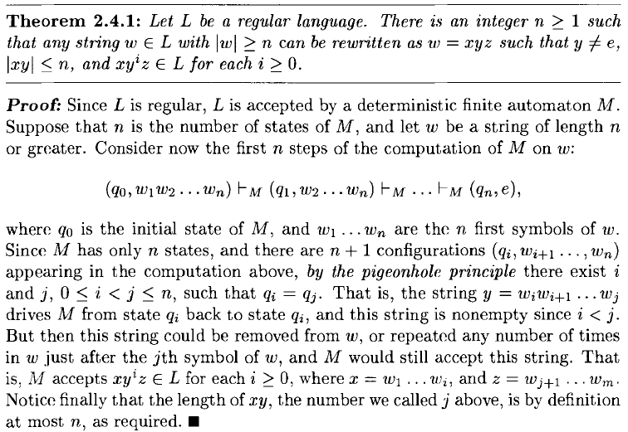
Pumping Theorem

Slide 43
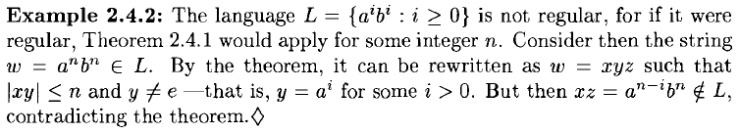
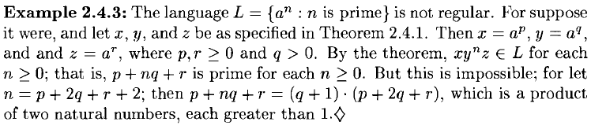
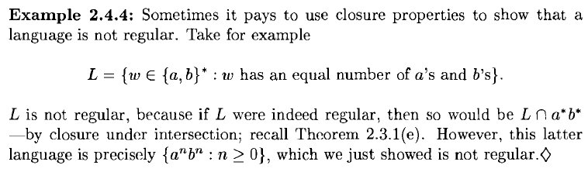

Slide 44
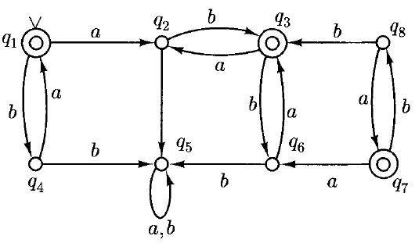

State Minimization
Example

Slide 45

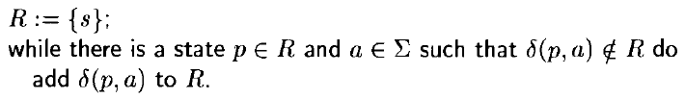

Slide 46
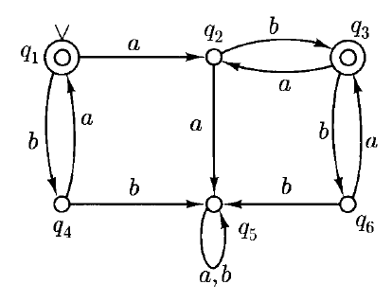
Equivalent - merge into one state

Slide 47




